Slide 1
Collecting Ego Network Data

Slide 2
Where does network data come from?
Surveys
  You ask people about their relations
    Best approach for the collection of ego network data

Slide 3
Where does network data come from?
Surveys
  You ask people about their relations
    Best approach for the collection of ego network data
Direct Observation
  You go to a site and record interactions between people
    Classrooms
    Neighborhoods
    Karate Club
    Monastery
    Frat House
    Beach?
Big Data - digital traces of communication, interaction

Slide 4
Where does network data come from?
Surveys
  You ask people about their relations
    Best approach for the collection of ego network data
Direct Observation
  You go to a site and record interactions between people
    Classrooms
    Neighborhoods
    Karate Club
    Monastery
    Frat House
    Beach?
Big Data - digital traces of communication, interaction

Slide 5
Where does network data come from?
Surveys
  You ask people about their relations
    Best approach for the collection of ego network data
Direct Observation
  You go to a site and record interactions between people
    Classrooms
    Neighborhoods
    Karate Club
    Monastery
    Frat House
    Beach?
Big Data - digital traces of communication, interaction

Slide 6
Ego (personal) networks
Sometimes the best way to figure out who a person is connected to is to ask them!
  This yields personal (ego) networks
  Information on:
    Ego (the individuals)
    Role, exchange, interaction relations between ego and a set of alters
    Relations among the alters from the point of view of ego
    Properties of each relation from the point of view of ego
b
a
c
Ego
h
d
g
e
f

Slide 7
Types of ties in ego networks
Role relations (states)
  Friends, kin, business partners
Interpersonal sentiments and cognitions
  Liking, trusting, acquaintanceship
Behavioral Social Interactions
  Calling, texting, citing, supporting, resource exchange
b
a
c
Ego
h
d
g
e
f

Slide 8
Measuring ego networks: Four steps
Pick a type of relation you are interested in
  This defines your name generator
Pick a maximum number of alters
  E.g. 5-20
Pick a set of alter and tie-level characteristics you are interested in
  This defines your name interpreter
Collect information about relations between alters (optional)
b
a
c
Ego
h
d
g
e
f

Slide 9
Measuring ego networks: Four steps
Pick a type of relation you are interested in
  This defines your name generator
Pick a maximum number of alters
  E.g. 5-20
Pick a set of alter and tie-level characteristics you are interested in
  This defines your name interpreter
Collect information about relations between alters (optional)
b
a
c
Ego
h
d
g
e
f

Slide 10
Measuring ego networks: Four steps
Pick a type of relation you are interested in
  This defines your name generator
Pick a maximum number of alters
  E.g. 5-20
Pick a set of alter and tie-level characteristics you are interested in
  This defines your name interpreter
Collect information about relations between alters (optional)
b
a
c
Ego
h
d
g
e
f

Slide 11
Measuring ego networks: Four steps
Pick a type of relation you are interested in
  This defines your name generator
Pick a maximum number of alters
  E.g. 5-20
Pick a set of alter and tie-level characteristics you are interested in
  This defines your name interpreter
Collect information about relations between alters (optional)
b
a
c
Ego
h
d
g
e
f

Slide 12
Measuring ego networks: Four steps
Pick a type of relation you are interested in
  This defines your name generator
Pick a maximum number of alters
  E.g. 5-20
Pick a set of alter and tie-level characteristics you are interested in
  This defines your name interpreter
Collect information about relations between alters (optional)
b
a
c
Ego
h
d
g
e
f

Slide 13
Name generators: Four approaches
Role-Relation Approach
  Neighbors, friends, kin, co-authors
Interaction Approach
  Frequency, duration of contact
Affective Approach
  Significant, close, enemies
Exchange Approach
  Information, favors, support, resources
Different approaches can produce ego-networks with different structural characteristics!
b
a
c
Ego
h
d
g
e
f

Slide 14
Name generators: Four approaches
Role-Relation Approach
  “list the names of up to [X] [friends, co-workers, co-authors, roommates, etc.]”
Interaction Approach
  “list the names of up to [X] of the people you most frequently interact with
Affective Approach
  “list the names of up to [X] of the people you [feel closest to, trust most, etc.]”
Exchange Approach
  “list the names of up to [X] of the people you would go to for [advice, financial support, etc.]
b
a
c
Ego
h
d
g
e
f

Slide 15
Name generators: Four approaches
Famous examples:
  Wellman’s (1979) East York Study:
    “Name the six persons outside your home that you feel closest to.”
  Fischer’s (1982) Northern California Communities Study:
    “Name all persons who would provide any of eight types of aid”
  Marsden’s (1987) General Social Survey:
    “Named all persons with whom you have discussed matters important to you”
b
a
c
Ego
h
d
g
e
f

Slide 16
Name generators: Four approaches
Role-Relation Approach
  Problem: low reliability, cultural specificity issues, cross-respondent heterogeneity in label interpretation (what is a “friend”?)
Interaction Approach
  Less validity issues than role-relations, but frequency does not equal importance/closeness (needs to be combined with other approaches)
Affective Approach
  Same reliability issues as role-relation items but useful for eliciting strong or subjectively significant ties; elicits smaller networks
Exchange Approach
  Less reliability problems, useful for social capital studies, but not appropriate for all purposes; can capture weak ties and larger number of alters

Slide 17
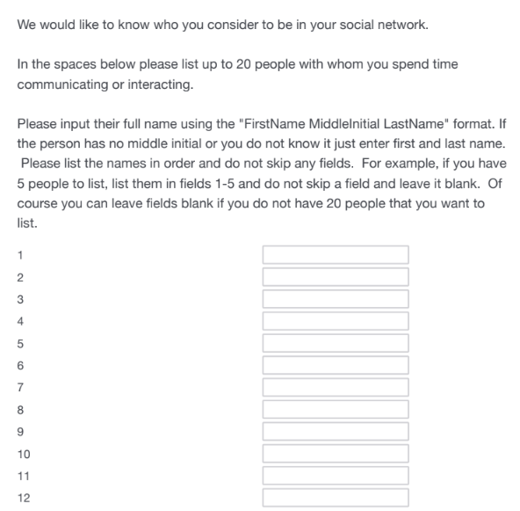
Name generators: Example
What’s the best approach?
Pick the “most-neutral” criterion for eliciting names
  Like interaction frequency)
  Then use name interpreters to get at roles, exchanges, sentiments and so on

Slide 18

Name interpreters
Follow up questions designed to get information on named alters
  Socio-demographic characteristics of alter
    Gender
    Age
    Race
    Years of Education
    Relationship to the organization
    Religion
    Etc.

Slide 19

Name interpreters
Follow up questions designed to get information on named alters
  Socio-demographic characteristics of alter
    Sex/Gender
    Age
    Race
    Years of Education
    Relationship to the organization
    Religion
    Etc.

Slide 20

Name interpreters
Follow up questions designed to get information on named alters
  Socio-demographic characteristics of alter
    Gender
    Age
    Race
    Years of Education
    Relationship to the organization
    Religion
    Etc.

Slide 21

Name interpreters
Follow up questions designed to get information on named alters
  Socio-demographic characteristics of alter
    Gender
    Age
    Race
    Years of Education
    Relationship to the organization
    Religion
    Etc.

Slide 22

Name interpreters
Follow up questions designed to get information on elicited relations
  Role-relations
    Friends, co-workers, co-authors, pub-mates
  Sentiments
    Loving, exciting, significant, negative sentiments (difficult person)
  Exchanges and Support
    Advice, would go to for financial help, discuss important matters, etc.
  Relationship age or duration
    How long have you known?

Slide 23

Name interpreters
Follow up questions designed to get information on elicited relations
  Role-relations
    Friends, co-workers, co-authors, pub-mates
  Sentiments
    Closeness, negative sentiments (difficult person)
  Exchanges and Support
    Advice, would go to for financial help, discuss important matters, etc.
  Relationship age or duration
    How long have you known?

Slide 24

Name interpreters
Follow up questions designed to get information on elicited relations
  Role-relations
    Friends, co-workers, co-authors, pub-mates
  Sentiments
    Closeness, negative sentiments (difficult person)
  Exchanges and Support
    Advice, would go to for financial help, discuss important matters, etc.
  Relationship age or duration
    How long have you known?

Slide 25

Name interpreters
Follow up questions designed to get information on elicited relations
  Role-relations
    Friends, co-workers, co-authors, pub-mates
  Sentiments
    Closeness, negative sentiments (difficult person)
  Exchanges and Support
    Advice, would go to for financial help, discuss important matters, etc.
  Relationship age or duration
    How long have you known?

Slide 26

Name interpreters
Follow up questions designed to get information on elicited relations
  Relationship age or duration
  Subjective similarity
  “Cultural matching”
    Does alter share tastes, attitudes, practices with ego?

Slide 27

Name interpreters
Follow up questions designed to get information on elicited relations
  Relationship age or duration
  Subjective similarity
  Similarities/Matching in Activities
    Does alter like to do similar things to what ego likes to do?

Slide 28
NetHealth Ego Network Data
Long file -- NetHealthNetworkSurveyDataFlat
  records are {egoid, alterid, wave}
  Egoid is person who completed the survey
  8 waves
Name generator -- interaction
  Up to 20
  Wave 3 began feeding back Wave N-1 names after subject lists people
  Asks for phone number and email for matching purposes

Slide 29
NetHealth Ego Network Data
Alter traits measured (via name interpreters)
  Demographic: Sex, race, age, education, religion
  Other traits: Health, happiness, activity, sleep, relation to ND,
  Relational traits: same dorm, roomate, duration, relation types (family, friend, etc.), frequency
  Affinity: closeness, (listing) position, trust
  Support: financial, comfort, social, advice
  Homophily: subject measure/rating, similarity on 5 activities
Connections among alters - clustering
  Another edge list: {alterid1, alterid2, egoid, wave} ; egoid is individual who reports existence alterid1-alterid2 tie at wave N.
  1.5 ego network
    note - not all of each alters alters. Only alters who are either ego, or one of ego’s alters

Slide 30
NetHealth Data - Research
Expands number of alters we have information on:
  In-study
  Named Alters
Network size for various types of relations: family, preND, post-ND friends
Compare measures of tie strength
Correspondence between “perceived” network and “actual” network.
Variation over time and between persons in ego network traits.

Slide 31
Alternatives: Position Generators
“Do you know anyone who is a/an….”
  Lawyer
  Doctor
  Mechanic
  Teacher
  Secretary
  Hairdresser
  Cook
  Farmer
  Mailman
  Policeman
  [...] And whatever other occupations you can imagine
b
a
c
Ego
h
d
g
e
f

Slide 32

Alternatives: Position Generators

Slide 33
Alternatives: Position Generators
Advantages:
  High criterion and face validity
  Quick and dirty (not lengthy)
  Occupational labels are easily understood by informants
  Easily standardized (occupational census codes)
  Captures lots of information with minimal strain
  Ideal for studies of social capital and access to resources
  Good measure of an individual's relational position in the occupational structure
  Can be followed by a “position interpreter” to collect data on tie linking ego to position
  Can be augmented by linking to objective information about each social position (e.g. average income, education, occupational prestige, etc.)
  Simple, intuitive metrics (e.g. number of positions accessed, prestige range, top rank, etc.)

Slide 34
Alternatives: Resource Generators
“Do you know anyone who…”
  Can repair a car, bike, etc.
  Is handy repairing household equipment
  Can speak and write a foreign language
  Can work with a personal computer
  Has good contacts with a newspaper, radio or TV station
  Has knowledge about financial matters (taxes, subsidies)
  Can give advice concerning a conflict at work
  Can help when moving house (packing, lifting)
  Can help with small jobs around the house (carpentering, painting)
  [...] And whatever else you can imagine

Slide 35

Alternatives: Resource Generators

Slide 36
Alternatives: Resource Generators
Advantages:
  Combines the practicality of the position generator with the detail of the name generator.
  Captures multiple dimensions of social support and connectivity.
  Allows for potential standardization of social capital measures.
  Covers several life domains.
  Uses simple, intuitive metrics (e.g., number, popularity, and range of resources accessed).
  Can empirically link resources to role-relations.

Slide 37
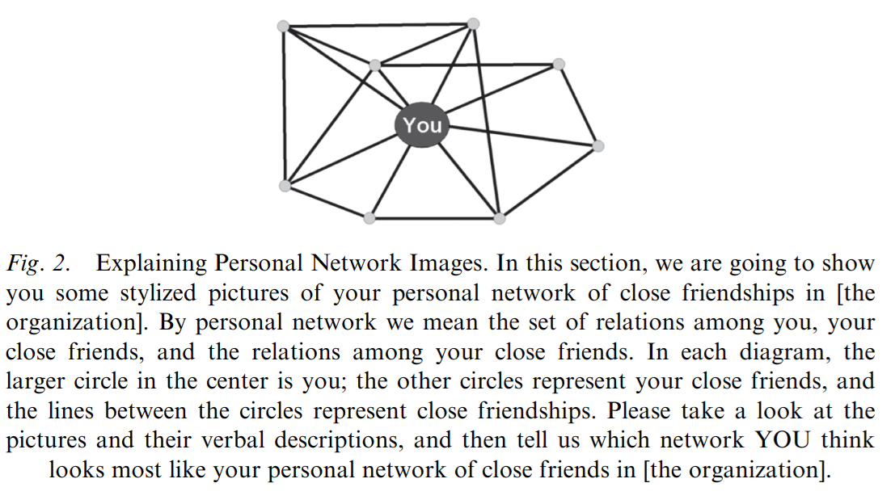
Alternatives: Visual network scales
We may be interested in the ways individuals perceive their position in a social network
  Visual network scales have been proposed as a viable method for this purpose
  The idea is to:
    Present people with idealized pictures of certain network scenarios
    Ask them to rate how closely their network resembles this scenario

Slide 38
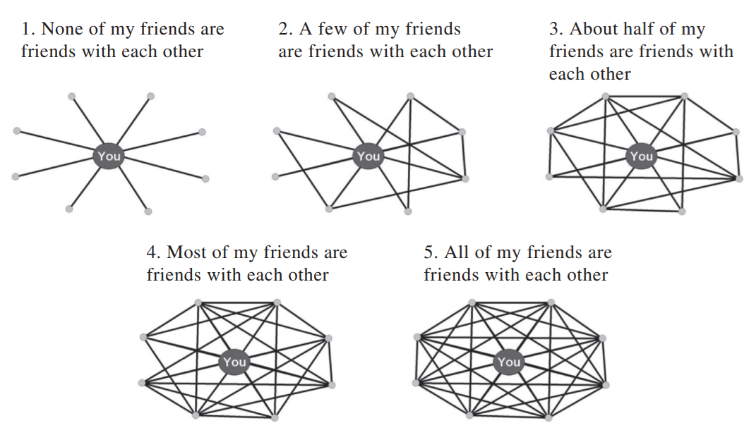
Alternatives: Visual network scales
We may be interested in whether people think they live in open versus clustered worlds.
  This question focuses on your perceptions of how interconnected your close friends are. Which of the network diagrams below best approximates the interconnectedness in your personal network of close friendships? Please choose one picture.

Slide 39
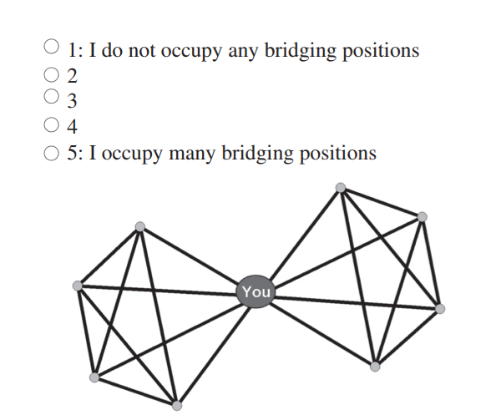
Alternatives: Visual network scales
We may be interested in whether people see themselves as bridges between groups.
  In the diagram, the large circle connecting the two groups/cliques is a bridge. Using the scale below, please rate the extent to which you think you occupy a bridging position in your personal network of close friendships—i.e., the extent to which you are close friends with groups that otherwise lack close friendship relations with each other.

Slide 40
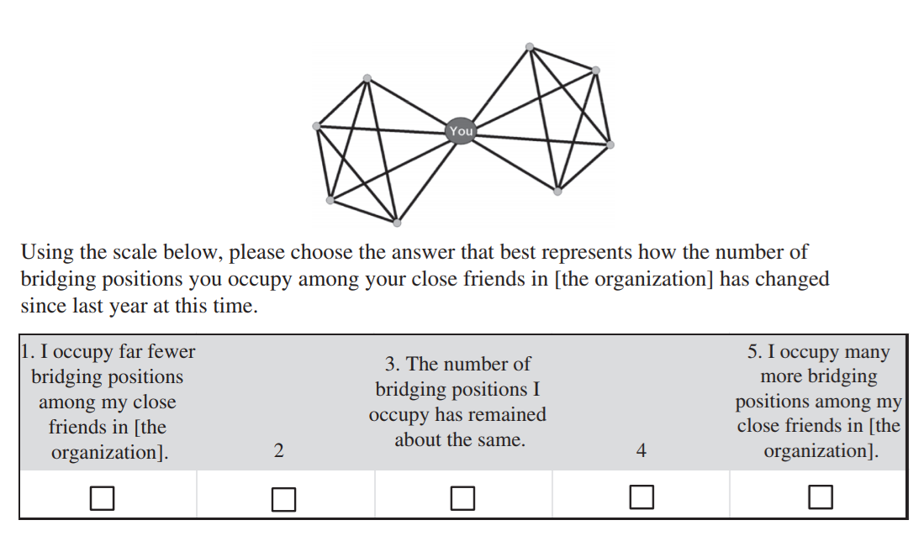
Alternatives: Visual network scales
We may also be interested in perceptions of social network position change over time:
  This question focuses on your perceptions of the CHANGE in the number of bridging positions you occupy among your close friends In the diagram below, there are two groups/cliques of people. The large circle that connects the two groups/cliques can be thought of as a bridge.

Slide 41
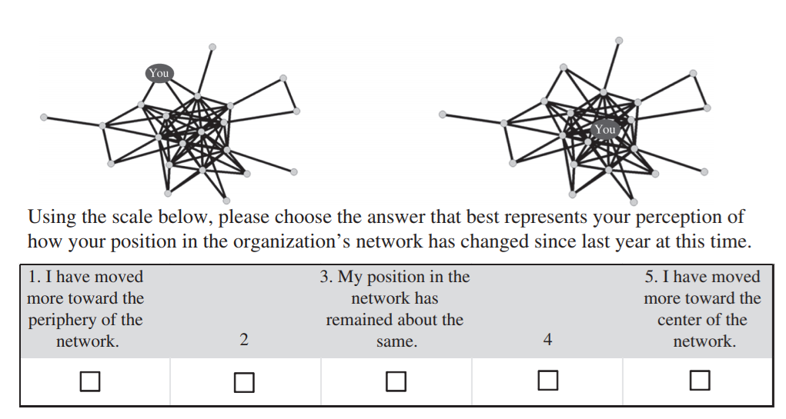
Alternatives: Visual network scales
We may also be interested in perceptions of social network position change over time:
  The network diagram on the left represents a person on the periphery of the network. This person has close friends who themselves are not connected to many others. The network diagram on the right represents a person in the center of the network. This person has close friends who themselves are connected to many others.

Slide 42

Measuring “social capital” in ego-networks
Often we are interested in eliciting ego-networks to get a sense of how “well-connected” the person is
  One criterion for being well-connected is the extent to which a person can potentially draw on resources embedded in relations
    This is called “social capital”
    Natural outgrowth of the exchange approach
  Invites a different measurement perspective

